Slide 1

Mobile Wizard Dress-Up Game
\

Slide 2
Scenario – Visual Novel
Visual Novel
Allows user to progress through a story with images.
Allows user to select choices that branch the story

Slide 3
Scenario – Mobile Game

Slide 4
Scenario – Dress Up Game

Slide 5
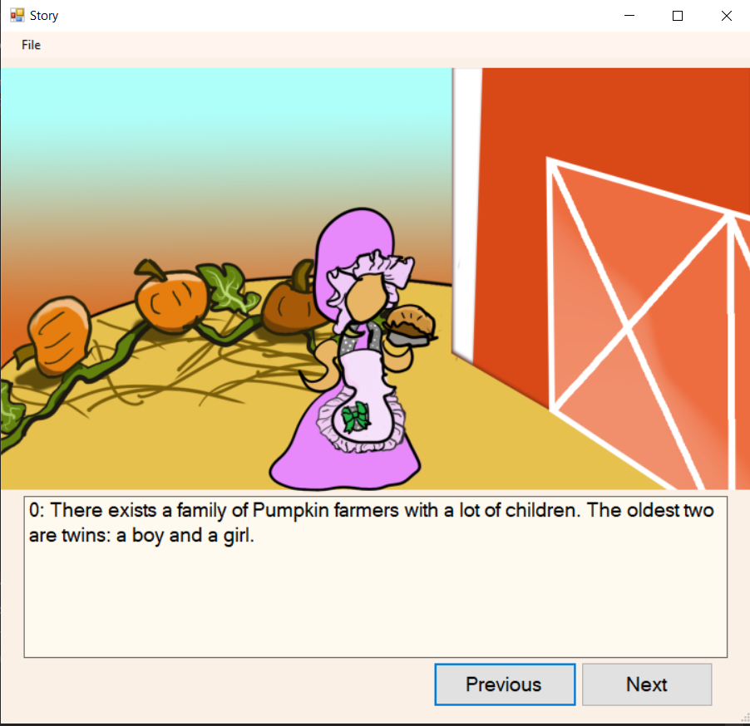
Prototypes - Visual Novel
First draft attempt done in Visual studio in C#.
The text is piped in from a text file, and there is currently an autogenerated number that allows for timing images correctly based on text location in array
Background image is set to stay until changed, foreground is set to vanish unless specified
Next button, and previous button in place
Currently has branching story abilities

Slide 6
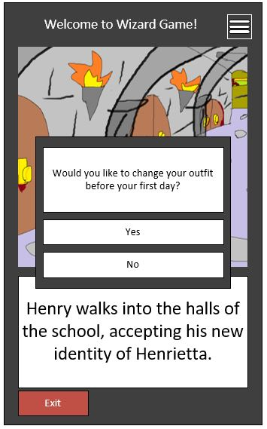
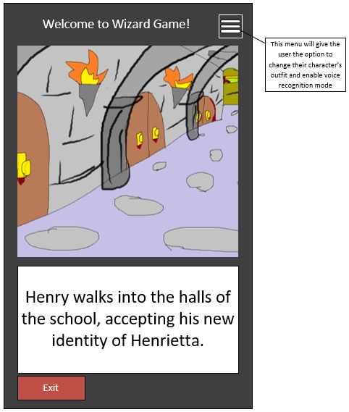
Prototypes – Mobile Game

Slide 7
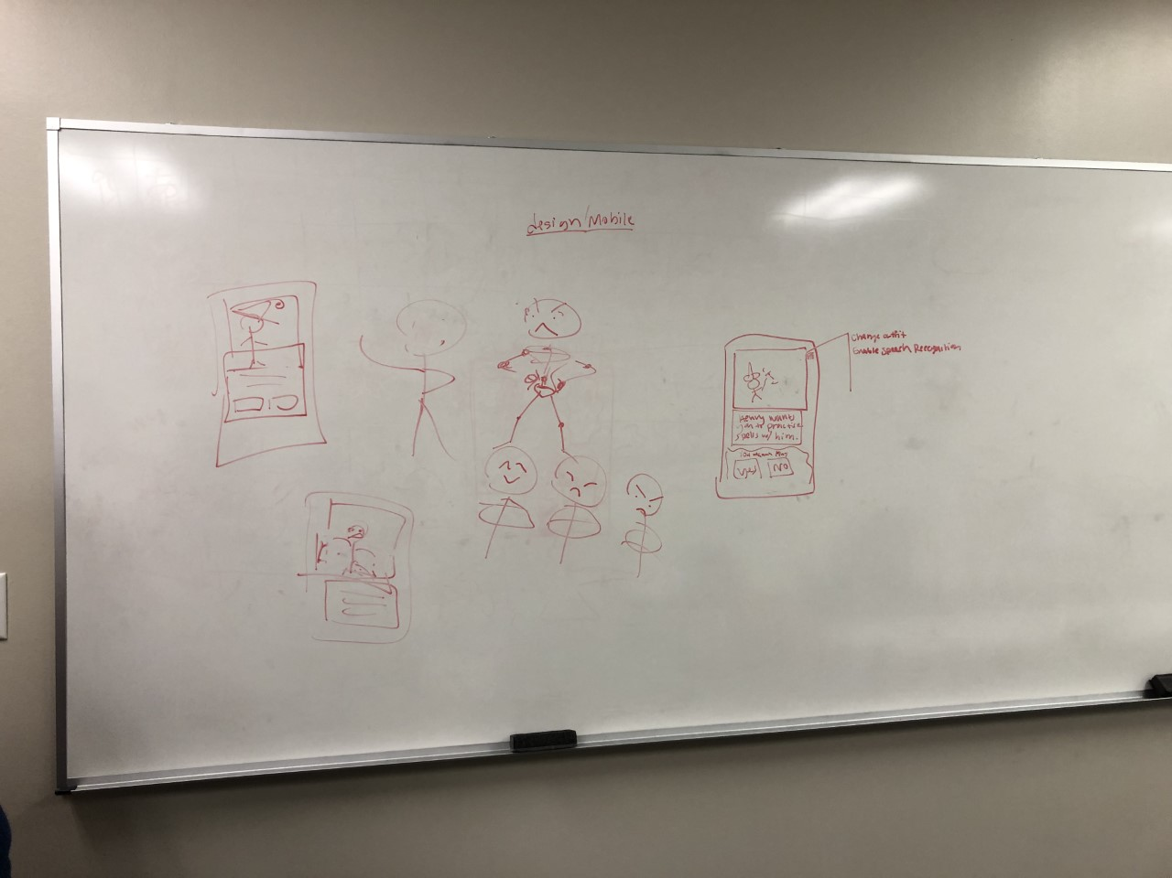
Prototypes – Dress Up

Slide 8
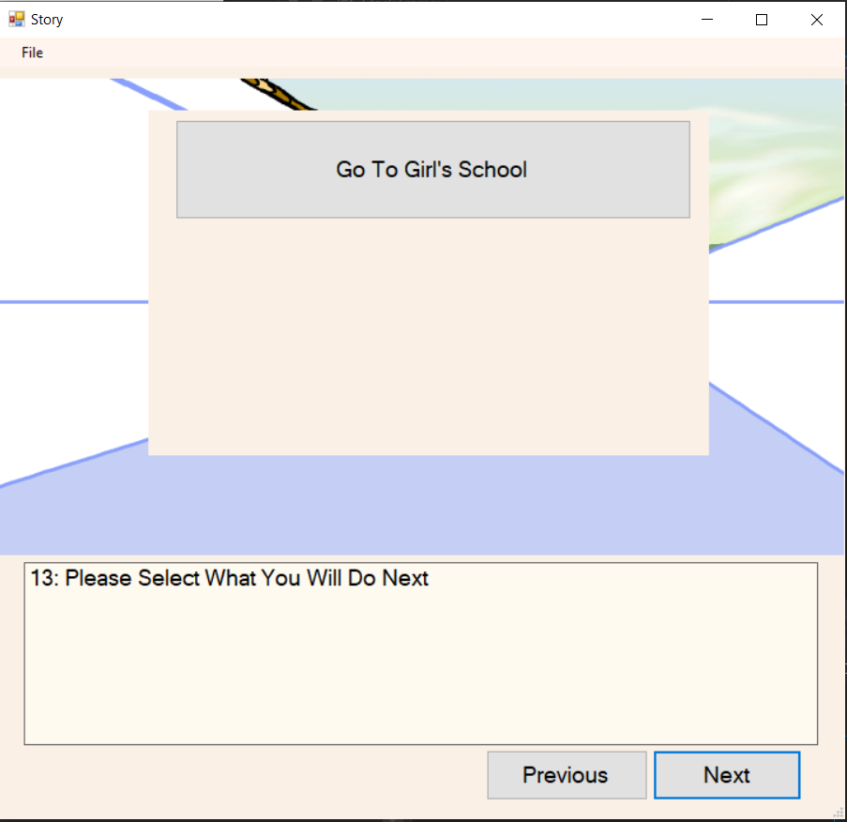
Design Rationale - Visual Novel
Images are a major part of the immersive exercise and therefore take up the lion’s share of the screen
Text is also imperative to tell the story, but does not need as much room as the image, it therefore takes the second most amount of space
User may want to review previous story point, particularly if a decision needs to be made, ergo both forward and backwards buttons are present
When selecting a branch the user should see the text that’s prompting the choice, ergo the image gets covered
User should not be overwhelmed, therefor limit choices to three at most

Slide 9
Design Rationale - Mobile Game
We need to keep everything on a relatively small screen with comparatively large text
Multiple Windows would be inefficient

Slide 10
Design Rationale – Dress Up

Slide 11
Challenges – Visual Novel
Smoothly combining with dress-up game
There may be branching story repercussions based on the score in the minigame
The outfit the main character is wearing may change based on it
The Windows Forms App in Visual Studio is ultimately not ideal for this project
The method I’m familiar with was for making forms with multiple windows, this project should all be out of one windows
We have decided to switch to Udemy, but as none of us are overly familiar with it that will include a higher learning curve.

Slide 12
Challenges - Mobile Game
The game will be mobile
Needs to make best use of real estate
Needs to resond to touch
Size of program becomes higher priority them mobile game

Slide 13
Challenges – Dress Up Game
Need ability to store wardrobe
Need clothing for character to alter image of character

Slide 14
Implementation Plan
Responsibility of Each Member
Anna -Visual Novel
Allie - Mobile Game
Gladys - Dress Up Interface
TimeLine:
By End of October: Get early draft of visual novel interface finished
By Mid November: Get Mobile Game and Dress Up Interface running independently
By End of November: Debug and get three sections working together

